Slide 1
A Statistical Analysis of Housing Price in Ames, Iowa
By Federico Chung, Elena Gottesman, Henry McCarthy
Notes:
All of us lol

Slide 2

Context - Why Ames?
Ames is the 7th most populous city in Iowa
While Ames may not have the highest population in the state, the presence of Iowa State University (the largest university in Iowa) makes it one of the more significant urban centers in the state
Ames makes for an interesting housing market study because of its substantial student population
Notes:
Henry

Slide 3

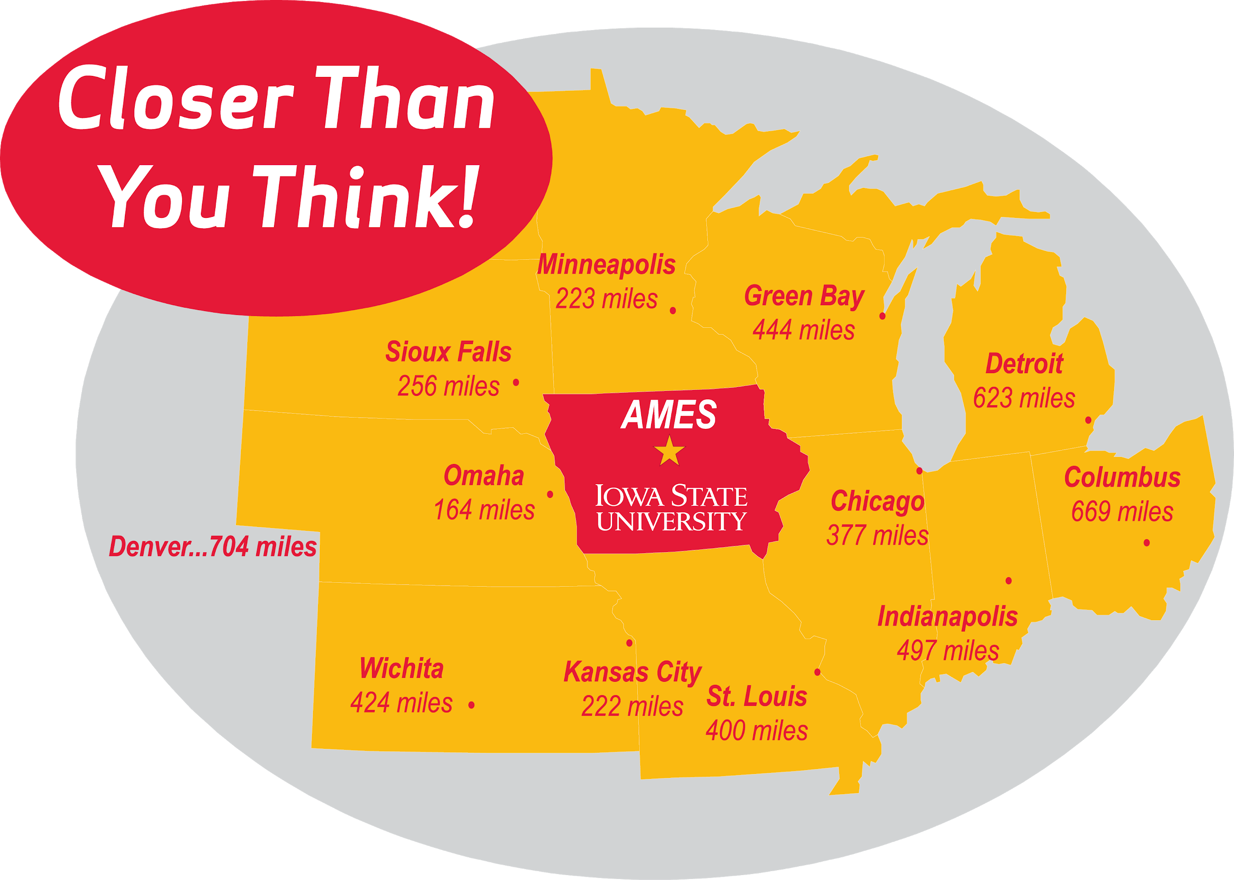
About the Data
All sales of residential property in Ames, Iowa between 2006 and 2010 (full population)
Dataset found on Kaggle
Originally compiled by Dean De Cock, a professor of statistics at Truman State University (Kirksville, MO)
Train and Test Data Provided
Train: 1460 rows x 81 columns
Test: 1459 rows x 80 columns
Dean De Cock
Notes:
Henry

Slide 4
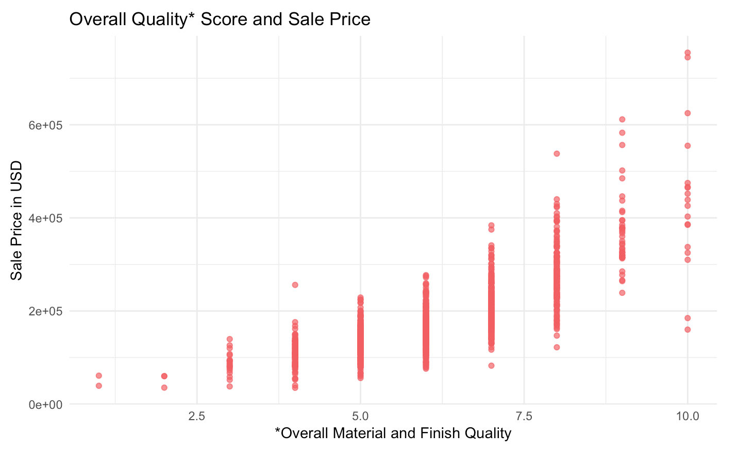
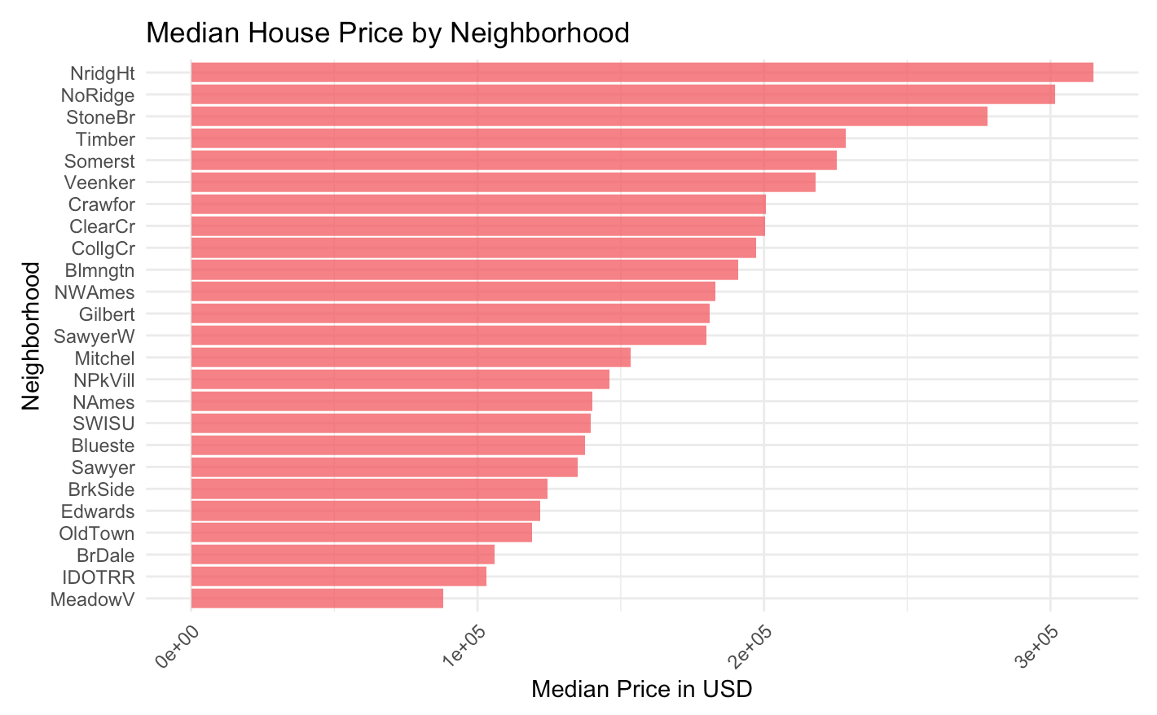
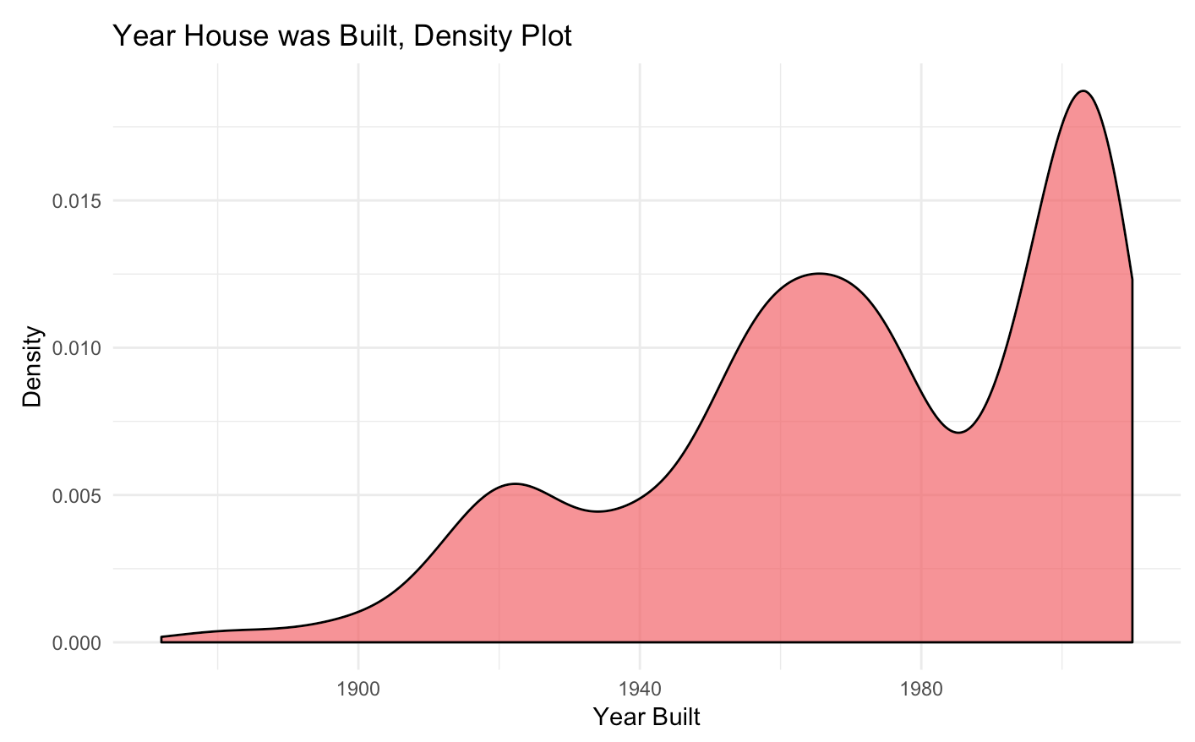
Our Three Selected Variables
After some preliminary summaries in R, we decided on three variables which had favorable R² values, p-values, and standard errors.
Overall Quality
Neighborhood
Year Built
Scored from 1 to 10
25 Neighborhoods
From 1872 to 2010
The most common Overall Quality score was 5, with a count of 397
Northridge Heights had the highest median house
price and Meadow Village had the lowest
The most houses built in a year was 67 houses in 2006
Notes:
Henry

Slide 5
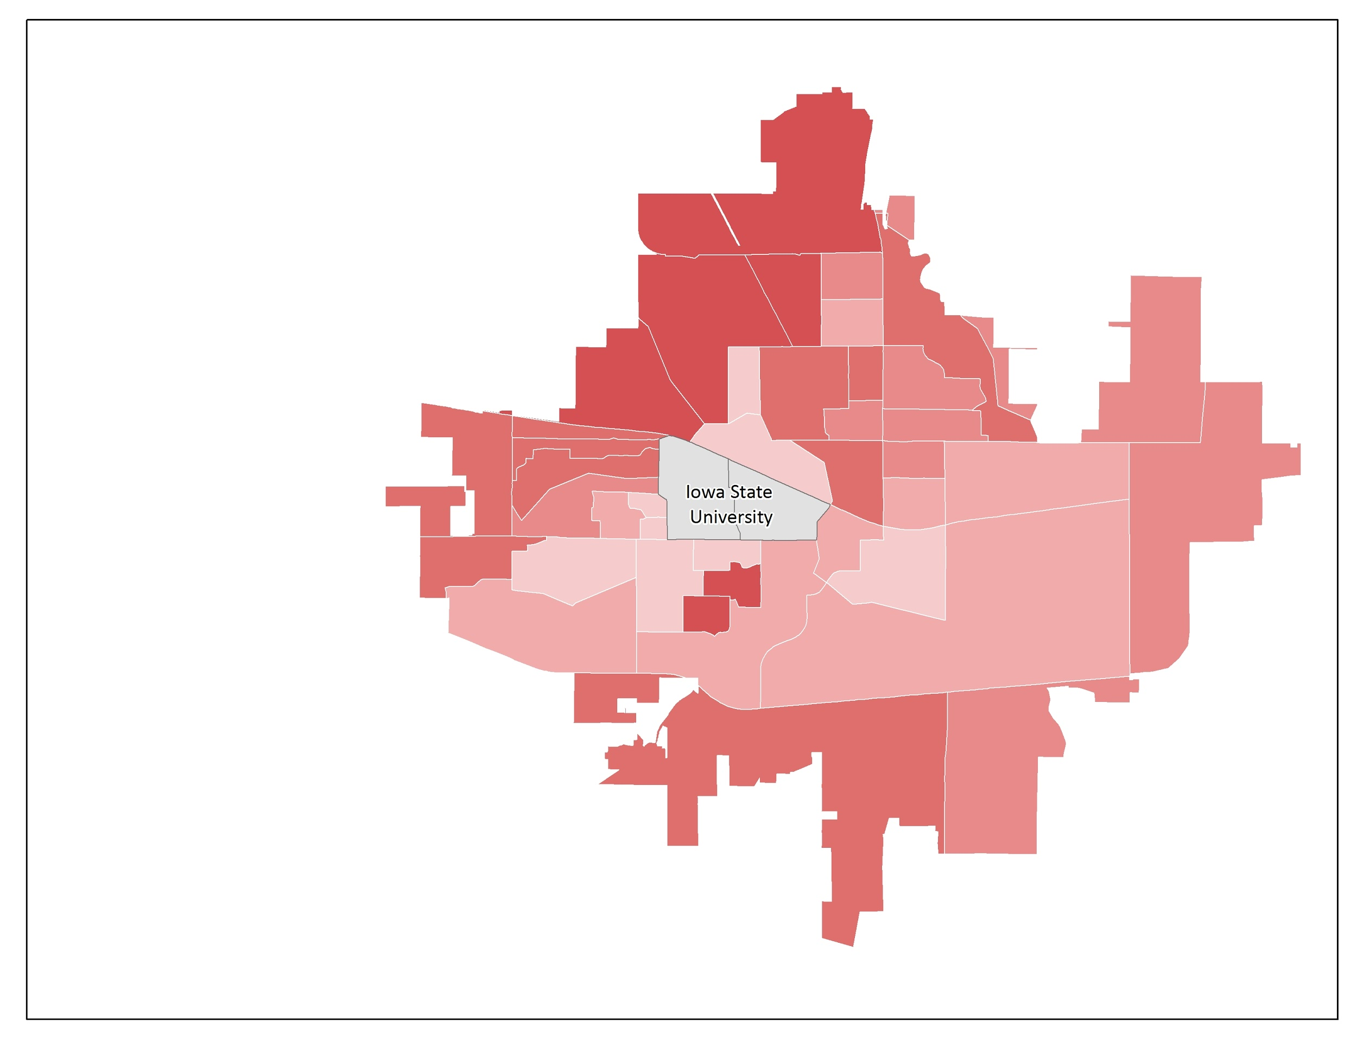
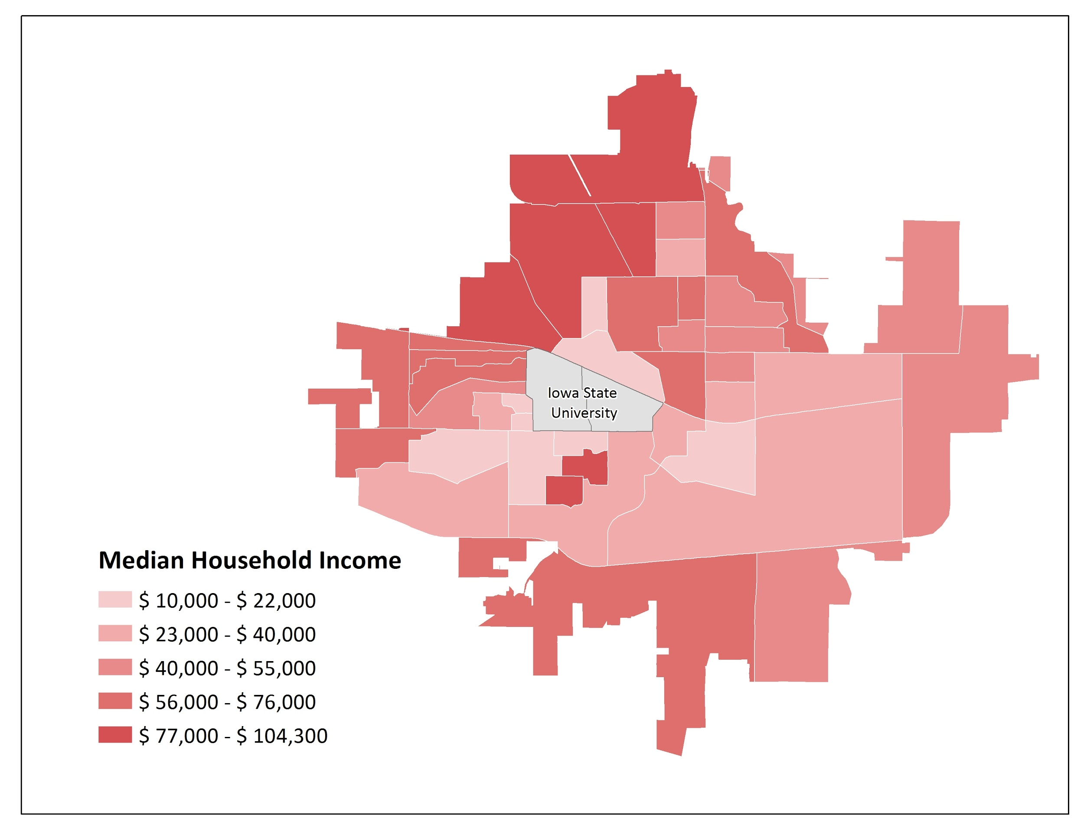
Geographic Distribution of Income in Ames
This map shows median household income by block group in the City of Ames, Iowa. Data was downloaded from the US Census bureau from the year 2013, three years after our housing market dataset.
Northridge Heights
Mean Home Sale Price: $180,921
Median Home Sale Price: $163,000
StdDev Home Sale Price: $79,442
Meadow Village
Northridge Heights and Meadow Village are highlighted because they are the neighborhoods with the highest and lowest home sale price values, respectively.
Notes:
Elena

Slide 6
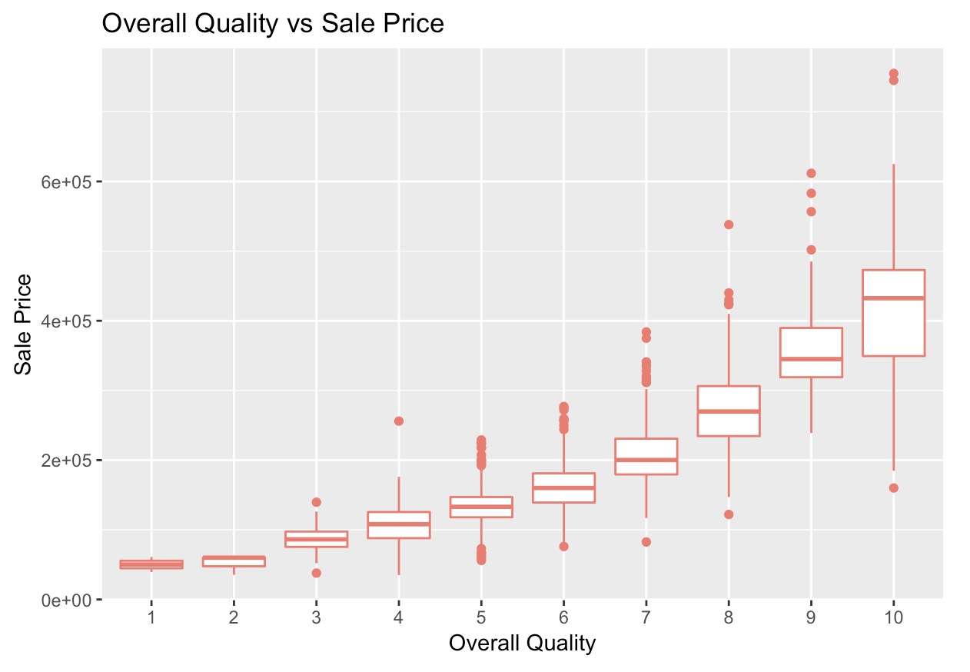
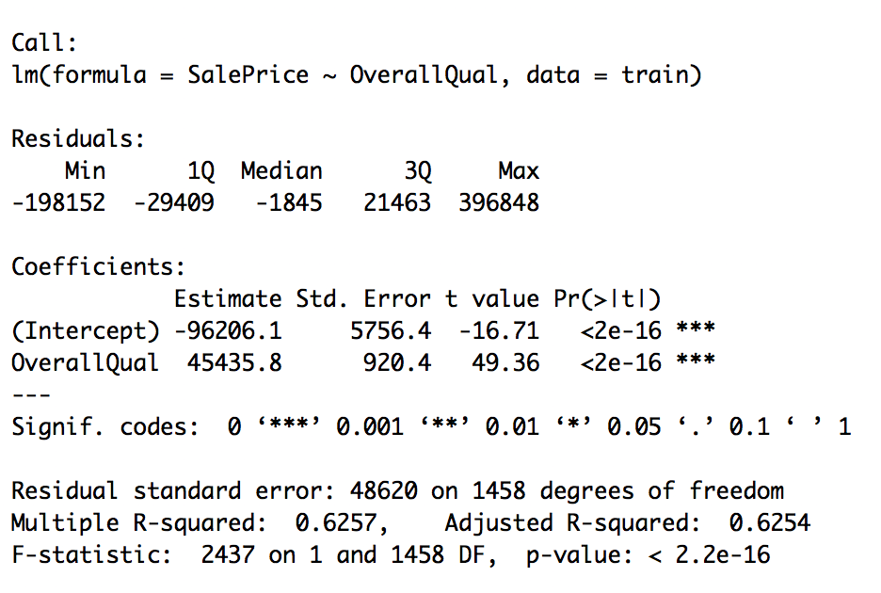
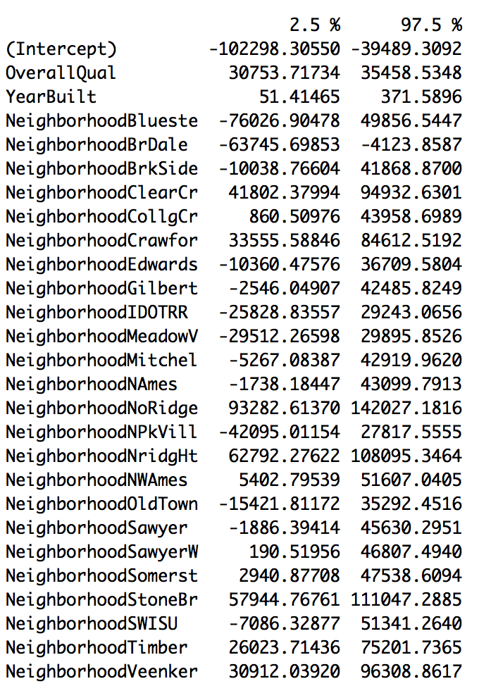
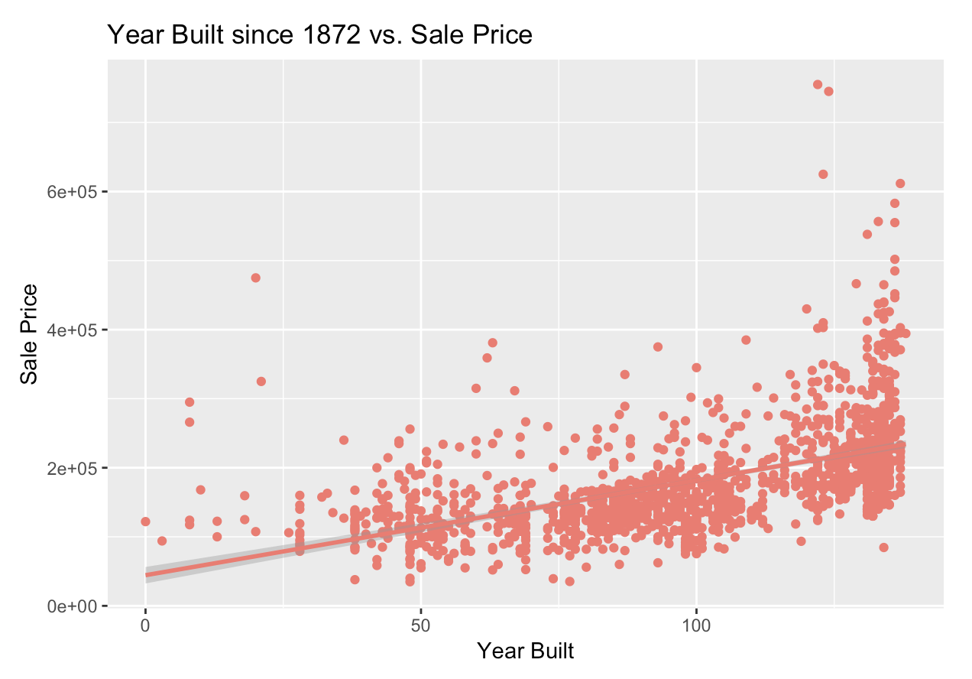
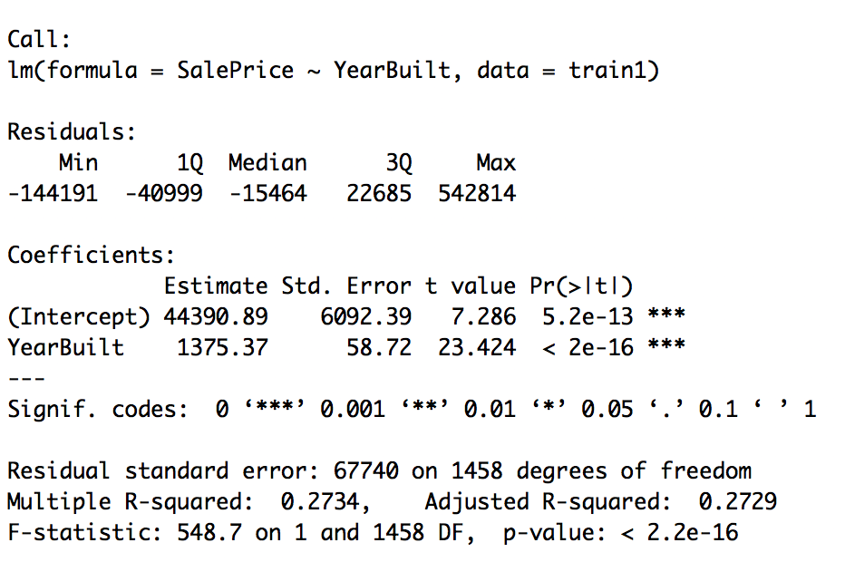
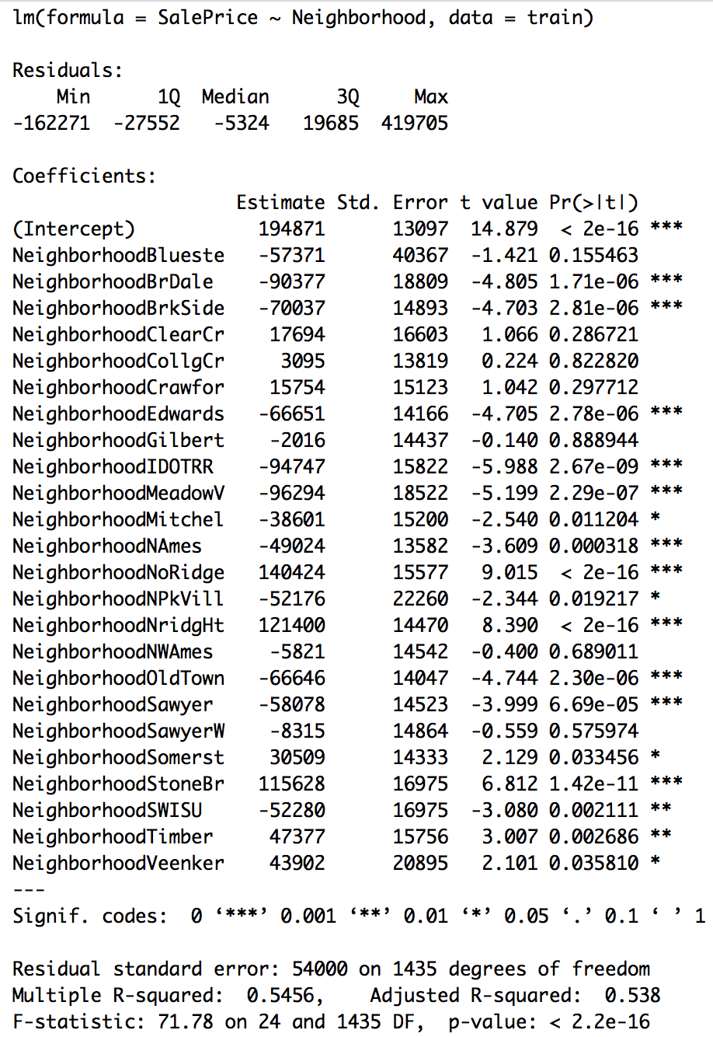
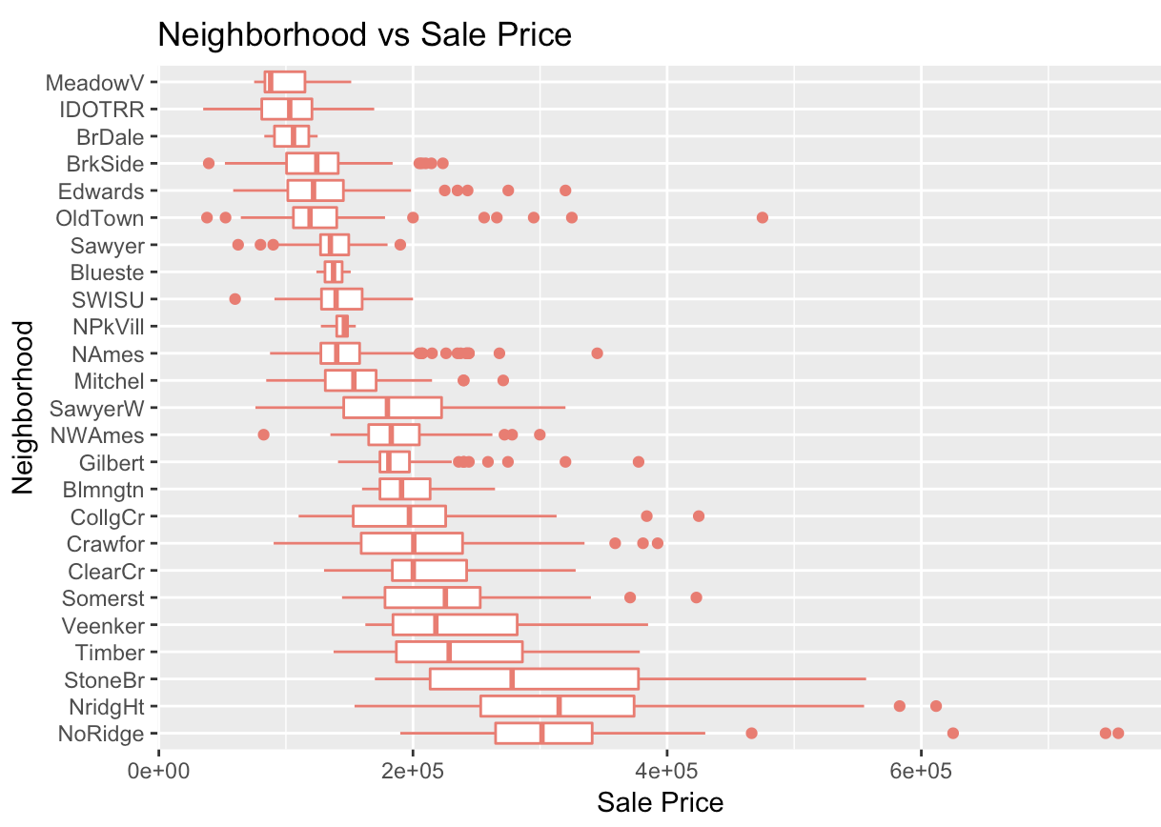
Modeling
To begin the modeling process, we tested our variables in models and plots to better understand the dimensions of our data.
Confidence Intervals

Slide 7
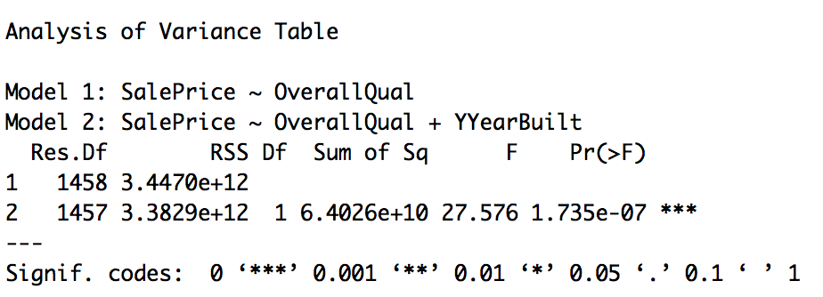
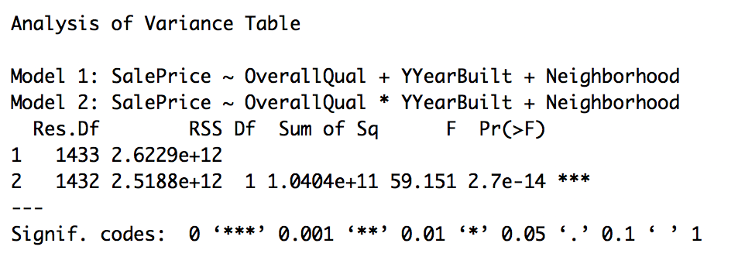
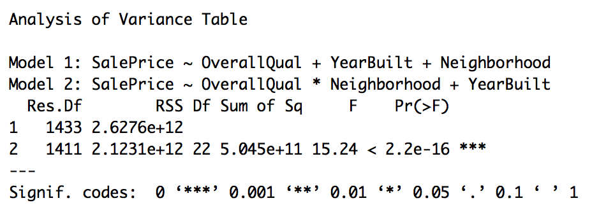
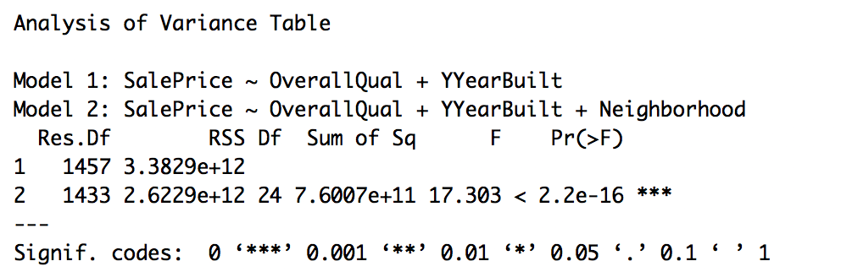
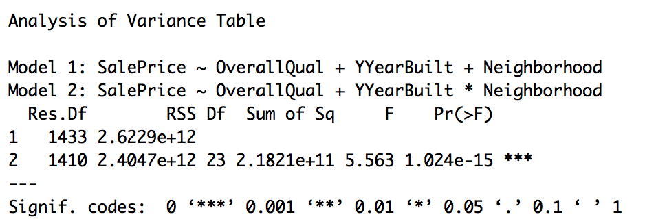
Modeling
Used Hypothesis testing and Model Selection using ANOVA
Notes:
Federico

Slide 8
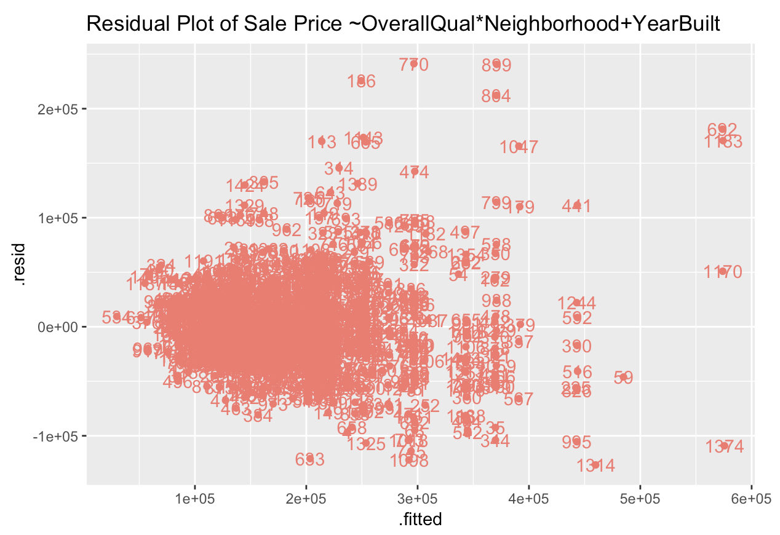
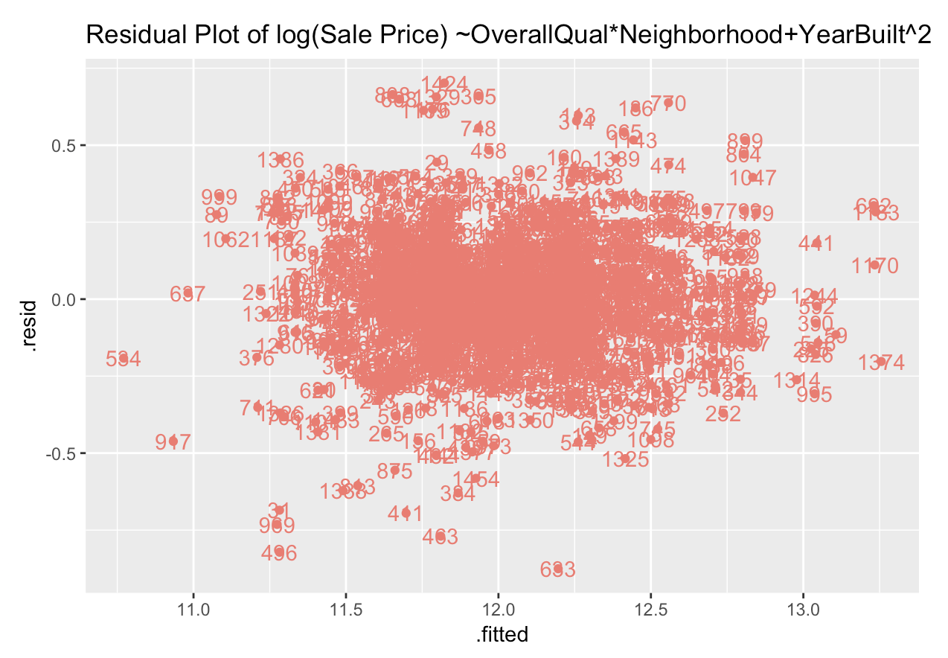
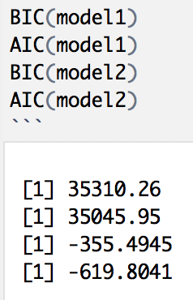
Model 1
Model 2
Some fanning and clustering in the initial residual plot meant we needed to adjust our model to get residuals that were more randomly distributed
This residual plot was the result of a model that looked at Sale Price as a function of Overall Quality, Year Built, and Neighborhood (using an interaction term between Overall Quality and Neighborhood)
We referred to Tukey’s Circle and Ladder of Powers to determine what transformations to make to our model
By taking the log of Sale Price as a function of Overall Quality, Neighborhood, and Year Built², we were able to achieve a more suitable residual plot
In previous iterations we had used multiple interaction terms, but we found that a single interaction term between Overall Quality and Neighborhood was suitable, and explained more variation.
In both models, we changed the Year Built variable to instead show the number of years since the first house was built (this was done by subtracting 1872 from the original Year Built variable)
Notes:
Elena

Slide 9
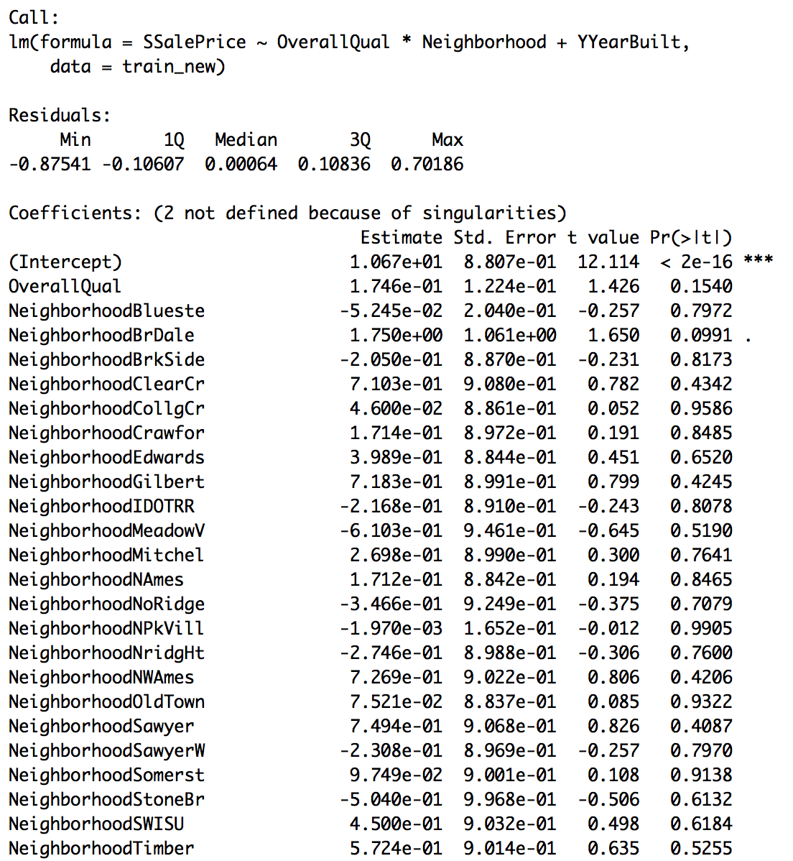
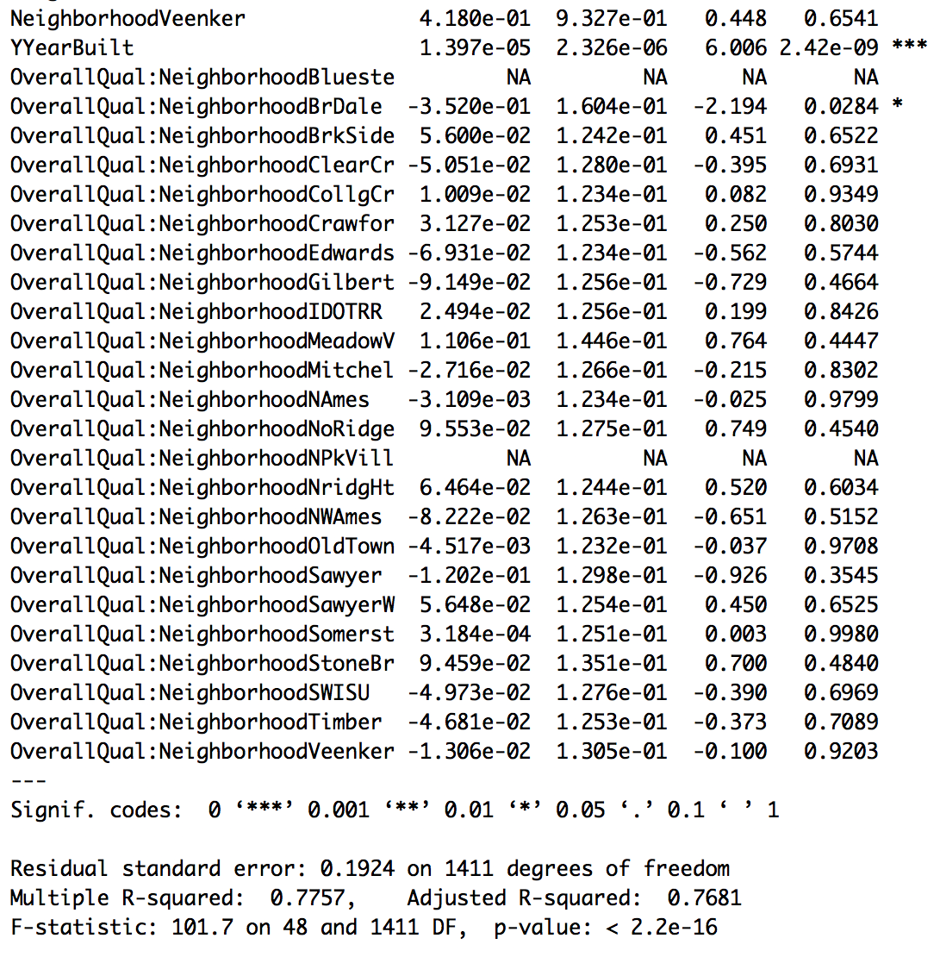
Modeling Results and Example prediction
Our predicted price for a house in Iowa DOT and Rail Road neighborhood, with an overall quality of 4, and built in year 1939 has a predicted sale price of:
81842.56 = e^(1.067e+01 - 2.168e-01 + 1.397e-05 *(1939 Year Built - 1872)^2 + (2.494e-02*4 Quality))
We expect that 95% of the time, our model predicts the house selling price to be between:
$61,325 and $109,223
Notes:
Federico

Slide 10
Limitations and Ethical Considerations
Sources
One of the primary variables we looked at was neighborhood, but the name and boundaries of a “neighborhood” can be quite subjective. The neighborhood boundaries listed in this dataset did not match up to other datasets or maps we found.
The results from this project only help describe the housing market in one city in Iowa
The subprime mortgage crisis in the United States lasted from 2007 to 2010, which means the majority of our data (2006 to 2010) has the potential to be classified as an outlier in a more comprehensive study of housing over time in the United States
The housing market in Ames is probably markedly different from other rural cities that do not have a large public university
https://www.kaggle.com/c/house-prices-advanced-regression-techniques
https://register.extension.iastate.edu/rerc/local/about-ames
https://www.truman.edu/faculty-staff/decock/
https://www.cityofames.org/about-ames
https://geodata.iowa.gov/dataset/2010-census-iowa
Notes:
Elena

